Slide 1

RECURRENT NEURAL NETWORKS
{Grady Kurpasi}
{SSIE 616}
{Prof H. Lewis}

Slide 2





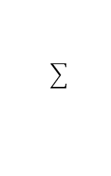








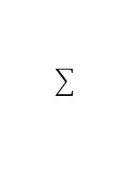




Multilayer Perceptrons
$$x, y$$
$$w_{1}[i,k]$$
$$w_{2}[k,j]$$
x₁ | x₂ | x₃ | y₁ | y₂
1.0000 | 4.0000 | 5.0000 | 0.1000 | 0.0500
0.1000 | -5.0000 | 3.0000 | 0.1221 | 0.0964
6.0000 | -5.5420 | 4.8970 | 0.1061 | 0.0702
4.0000 | 8.0000 | 9.0000 | 0.0996 | 0.0641
12.0000 | -2.0000 | 0.0063 | 0.1110 | 0.0732
6.0000 | -5.5000 | 4.8970 | 0.1060 | 0.0701
i | w[i,1] | w[i,2]
0 | 0.5 | 0.5
1 | 0.1 | 0.2
2 | 0.3 | 0.4
3 | 0.5 | 0.6
k | w[k,1] | w[k,2]
0 | 0.5 | 0.5
1 | 0.7 | 0.8
2 | 0.9 | 0.1
$$a_{2}\left[j\right]$$
j = 1..n
n = 2
# output
$$a_{2}[1]$$
$$a_{2}[2]$$
$$a_{1}[k]$$
k = 1..l
$$a_{1}[k]$$
1
l = 2
# hidden
$$a_{1}[0]$$
$$a_{1}[1]$$
$$a_{1}[2]$$
$$a_{0}[i]$$
i = 1..m
1
x
x
x
m = 2
# input
$$a_{0}[0]$$
$$a_{0}[1]$$
$$a_{0}[2]$$
$$a_{0}[3]$$
3-2-2 Multilayer Perceptron

Slide 3
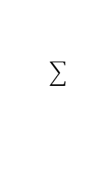











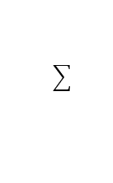

Multilayer Perceptrons
$$x, y$$
$$w_{1}[i,k]$$
$$w_{2}[k,j]$$
x₁ | x₂ | x₃ | y₁ | y₂
1.0000 | 4.0000 | 5.0000 | 0.1000 | 0.0500
0.1000 | -5.0000 | 3.0000 | 0.1221 | 0.0964
6.0000 | -5.5420 | 4.8970 | 0.1061 | 0.0702
4.0000 | 8.0000 | 9.0000 | 0.0996 | 0.0641
12.0000 | -2.0000 | 0.0063 | 0.1110 | 0.0732
6.0000 | -5.5000 | 4.8970 | 0.1060 | 0.0701
i | w[i,1] | w[i,2]
0 | 0.5 | 0.5
1 | 0.1 | 0.2
2 | 0.3 | 0.4
3 | 0.5 | 0.6
k | w[k,1] | w[k,2]
0 | 0.5 | 0.5
1 | 0.7 | 0.8
2 | 0.9 | 0.1
$$a_{2}\left[j\right]$$
j = 1..n
$$a_{2}[1]$$
$$a_{2}[2]$$
$${subscript}_{2}$$
$$a_{1}[k]$$
k = 1..l
$$a_{1}[k]$$
1
1
$$a_{1}[0]$$
$$a_{1}[1]$$
$$a_{1}[2]$$
$${subscript}_{1}$$
$$a_{0}[i]$$
i = 1..m
1
x
x
x
x
x
x
x
1
x
$${subscript}_{0}$$
$$a_{0}[0]$$
$$a_{0}[1]$$
$$a_{0}[2]$$
$$a_{0}[3]$$
3-2-2 Multilayer Perceptron

Slide 4



Multilayer Perceptrons
$$x, y$$
$$w_{1}[i,k]$$
$$w_{2}[k,j]$$
x₁ | x₂ | x₃ | y₁ | y₂
1.0000 | 4.0000 | 5.0000 | 0.1000 | 0.0500
0.1000 | -5.0000 | 3.0000 | 0.1221 | 0.0964
6.0000 | -5.5420 | 4.8970 | 0.1061 | 0.0702
4.0000 | 8.0000 | 9.0000 | 0.0996 | 0.0641
12.0000 | -2.0000 | 0.0063 | 0.1110 | 0.0732
6.0000 | -5.5000 | 4.8970 | 0.1060 | 0.0701
i | w[i,1] | w[i,2]
0 | 0.5 | 0.5
1 | 0.1 | 0.2
2 | 0.3 | 0.4
3 | 0.5 | 0.6
k | w[k,1] | w[k,2]
0 | 0.5 | 0.5
1 | 0.7 | 0.8
2 | 0.9 | 0.1
$$a_{2}\left[j\right]$$
$$a_{2}[1]$$
$$a_{2}[2]$$
$$a_{1}[k]$$
$$a_{1}[k]$$
1
$$a_{1}[0]$$
$$a_{1}[1]$$
$$a_{1}[2]$$
$$a_{0}[i]$$
1
x
x
x
$$a_{0}[0]$$
$$a_{0}[1]$$
$$a_{0}[2]$$
$$a_{0}[3]$$

Slide 5
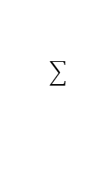
Multilayer Perceptrons
$$x, y$$
$$w_{1}[i,k]$$
$$w_{2}[k,j]$$
x₁ | x₂ | x₃ | y₁ | y₂
1.0000 | 4.0000 | 5.0000 | 0.1000 | 0.0500
0.1000 | -5.0000 | 3.0000 | 0.1221 | 0.0964
6.0000 | -5.5420 | 4.8970 | 0.1061 | 0.0702
4.0000 | 8.0000 | 9.0000 | 0.0996 | 0.0641
12.0000 | -2.0000 | 0.0063 | 0.1110 | 0.0732
6.0000 | -5.5000 | 4.8970 | 0.1060 | 0.0701
i | w[i,1] | w[i,2]
0 | 0.5 | 0.5
1 | 0.1 | 0.2
2 | 0.3 | 0.4
3 | 0.5 | 0.6
k | w[k,1] | w[k,2]
0 | 0.5 | 0.5
1 | 0.7 | 0.8
2 | 0.9 | 0.1
$$a_{2}\left[j\right]$$
$$a_{2}[1]$$
$$a_{2}[2]$$
$$a_{1}[k]$$
$$a_{1}[k]$$
1
$$a_{1}[0]$$
$$a_{1}[1]$$
$$a_{1}[2]$$
$$a_{0}[i]$$
1
x
x
x
$$a_{0}[0]$$
$$a_{0}[1]$$
$$a_{0}[2]$$
$$a_{0}[3]$$

Slide 6
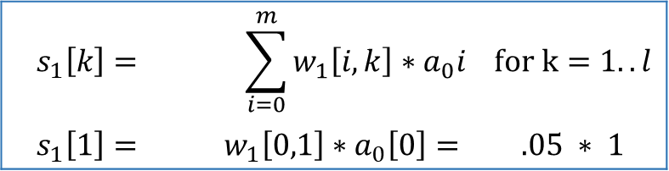
Forward Propagation
$$x, y$$
$$w_{1}[i,k]$$
$$w_{2}[k,j]$$
x₁ | x₂ | x₃ | y₁ | y₂
1.0000 | 4.0000 | 5.0000 | 0.1000 | 0.0500
i | w[i,1] | w[i,2]
0 | 0.5 | 0.5
1 | 0.1 | 0.2
2 | 0.3 | 0.4
3 | 0.5 | 0.6
k | w[k,1] | w[k,2]
0 | 0.5 | 0.5
1 | 0.7 | 0.8
2 | 0.9 | 0.1
$$a_{2}\left[j\right]$$
$$s_{1}\left[k\right]=$$ | $$\sum_{i=0}^{m}{w_{1}\left[i,k\right]∗a_{0}i}$$ | $$for k=1..l$$
$$s_{1}\left[1\right]=$$ | $$w_{1}\left[0,1\right]∗a_{0}\left[0\right]=$$ | $$.05 ∗ 1$$
$$a_{2}[1]$$
$$a_{2}[2]$$
$$a_{1}[k]$$
$$a_{1}[k]$$
1
$$a_{1}[0]$$
$$a_{1}[1]$$
$$a_{1}[2]$$
$$a_{0}[i]$$
1
1
4
5
$$a_{0}[0]$$
$$a_{0}[1]$$
$$a_{0}[2]$$
$$a_{0}[3]$$

Slide 7
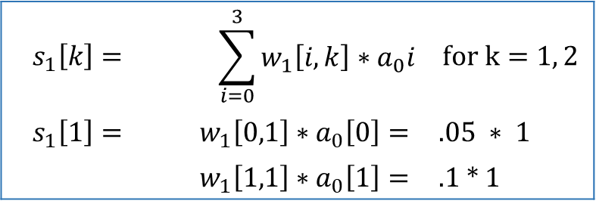
Forward Propagation
$$x, y$$
$$w_{1}[i,k]$$
$$w_{2}[k,j]$$
x₁ | x₂ | x₃ | y₁ | y₂
1.0000 | 4.0000 | 5.0000 | 0.1000 | 0.0500
i | w[i,1] | w[i,2]
0 | 0.5 | 0.5
1 | 0.1 | 0.2
2 | 0.3 | 0.4
3 | 0.5 | 0.6
k | w[k,1] | w[k,2]
0 | 0.5 | 0.5
1 | 0.7 | 0.8
2 | 0.9 | 0.1
$$a_{2}\left[j\right]$$
$$s_{1}\left[k\right]=$$ | $$\sum_{i=0}^{3}{w_{1}\left[i,k\right]∗a_{0}i}$$ | $$for k=1, 2$$
$$s_{1}\left[1\right]=$$ | $$w_{1}\left[0,1\right]∗a_{0}\left[0\right]=$$ | $$.05 ∗ 1$$
 | $$w_{1}\left[1,1\right]∗a_{0}\left[1\right]=$$ | .1 * 1
$$a_{2}[1]$$
$$a_{2}[2]$$
$$a_{1}[k]$$
$$a_{1}[k]$$
1
$$a_{1}[0]$$
$$a_{1}[1]$$
$$a_{1}[2]$$
$$a_{0}[i]$$
1
1
4
5
$$a_{0}[0]$$
$$a_{0}[1]$$
$$a_{0}[2]$$
$$a_{0}[3]$$

Slide 8
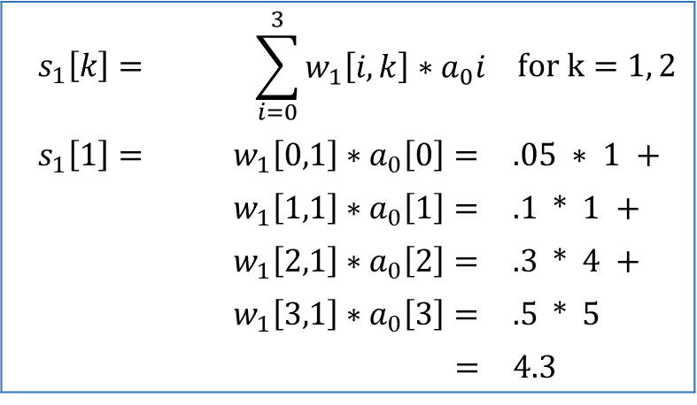
Forward Propagation
$$x, y$$
$$w_{1}[i,k]$$
$$w_{2}[k,j]$$
x₁ | x₂ | x₃ | y₁ | y₂
1.0000 | 4.0000 | 5.0000 | 0.1000 | 0.0500
i | w[i,1] | w[i,2]
0 | 0.5 | 0.5
1 | 0.1 | 0.2
2 | 0.3 | 0.4
3 | 0.5 | 0.6
k | w[k,1] | w[k,2]
0 | 0.5 | 0.5
1 | 0.7 | 0.8
2 | 0.9 | 0.1
$$a_{2}\left[j\right]$$
$$s_{1}\left[k\right]=$$ | $$\sum_{i=0}^{3}{w_{1}\left[i,k\right]∗a_{0}i}$$ | $$for k=1, 2$$
$$s_{1}\left[1\right]=$$ | $$w_{1}\left[0,1\right]∗a_{0}\left[0\right]=$$ | $.05 ∗ 1$ +
 | $$w_{1}\left[1,1\right]∗a_{0}\left[1\right]=$$ | .1 * 1 +
 | $$w_{1}\left[2,1\right]∗a_{0}\left[2\right]=$$ | .3 * 4 +
 | $$w_{1}\left[3,1\right]∗a_{0}\left[3\right]=$$ | .5 * 5
 | $=$ | 4.3
$$a_{2}[1]$$
$$a_{2}[2]$$
$$a_{1}[k]$$
$$a_{1}[k]$$
1
$$a_{1}[0]$$
$$a_{1}[1]$$
$$a_{1}[2]$$
$$a_{0}[i]$$
1
1
4
5
$$a_{0}[0]$$
$$a_{0}[1]$$
$$a_{0}[2]$$
$$a_{0}[3]$$

Slide 9
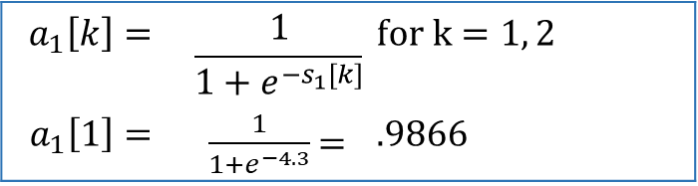
Forward Propagation
$$x, y$$
$$w_{1}[i,k]$$
$$w_{2}[k,j]$$
x₁ | x₂ | x₃ | y₁ | y₂
1.0000 | 4.0000 | 5.0000 | 0.1000 | 0.0500
i | w[i,1] | w[i,2]
0 | 0.5 | 0.5
1 | 0.1 | 0.2
2 | 0.3 | 0.4
3 | 0.5 | 0.6
k | w[k,1] | w[k,2]
0 | 0.5 | 0.5
1 | 0.7 | 0.8
2 | 0.9 | 0.1
$$a_{2}\left[j\right]$$
$$a_{1}\left[k\right]=$$ | $$\frac{1}{{1+e}^{{−s}_{1}[k]}}$$ | $$for k=1, 2$$
$$a_{1}\left[1\right]=$$ | $\frac{1}{{1+e}^{−4.3}}$ = | $$.9866$$
$$a_{2}[1]$$
$$a_{2}[2]$$
$$a_{1}[k]$$
$$a_{1}[k]$$
1
$$a_{1}[0]$$
$$a_{1}[1]$$
$$a_{1}[2]$$
$$a_{0}[i]$$
1
1
4
5
$$a_{0}[0]$$
$$a_{0}[1]$$
$$a_{0}[2]$$
$$a_{0}[3]$$

Slide 10
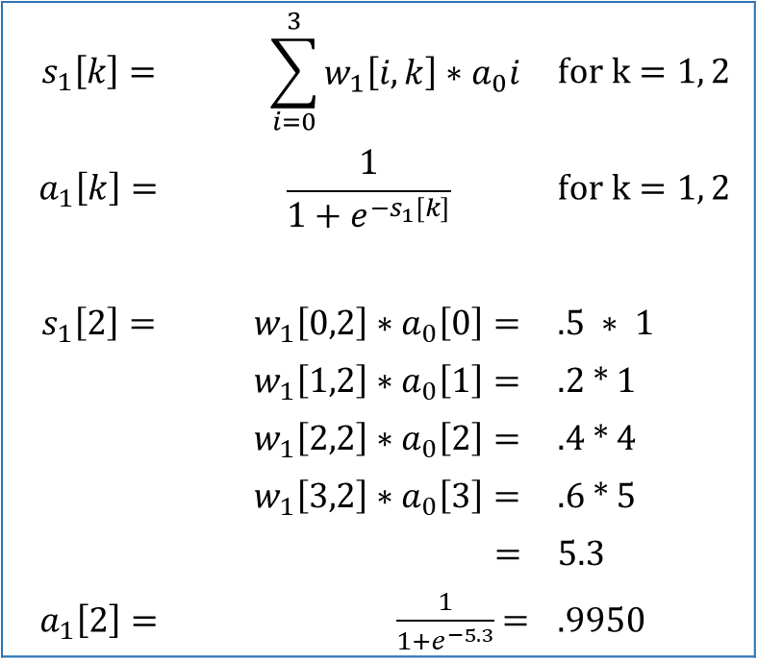
Forward Propagation
$$x, y$$
$$w_{1}[i,k]$$
$$w_{2}[k,j]$$
x₁ | x₂ | x₃ | y₁ | y₂
1.0000 | 4.0000 | 5.0000 | 0.1000 | 0.0500
i | w[i,1] | w[i,2]
0 | 0.5 | 0.5
1 | 0.1 | 0.2
2 | 0.3 | 0.4
3 | 0.5 | 0.6
k | w[k,1] | w[k,2]
0 | 0.5 | 0.5
1 | 0.7 | 0.8
2 | 0.9 | 0.1
$$a_{2}\left[j\right]$$
$$s_{1}\left[k\right]=$$ | $$\sum_{i=0}^{3}{w_{1}\left[i,k\right]∗a_{0}i}$$ | $$for k=1, 2$$
$$a_{1}\left[k\right]=$$ | $$\frac{1}{{1+e}^{{−s}_{1}[k]}}$$ | $$for k=1, 2$$
$$s_{1}\left[2\right]=$$ | $$w_{1}\left[0,2\right]∗a_{0}\left[0\right]=$$ | $$.5 ∗ 1$$
 | $$w_{1}\left[1,2\right]∗a_{0}\left[1\right]=$$ | .2 * 1
 | $$w_{1}\left[2,2\right]∗a_{0}\left[2\right]=$$ | .4 * 4
 | $$w_{1}\left[3,2\right]∗a_{0}\left[3\right]=$$ | .6 * 5
 | $=$ | 5.3
$$a_{1}\left[2\right]=$$ | $\frac{1}{{1+e}^{−5.3}}$ = | $$.9950$$
$$a_{2}[1]$$
$$a_{2}[2]$$
$$a_{1}[k]$$
$$a_{1}[k]$$
1
$$a_{1}[0]$$
$$a_{1}[1]$$
$$a_{1}[2]$$
$$a_{0}[i]$$
1
1
4
5
$$a_{0}[0]$$
$$a_{0}[1]$$
$$a_{0}[2]$$
$$a_{0}[3]$$

Slide 11
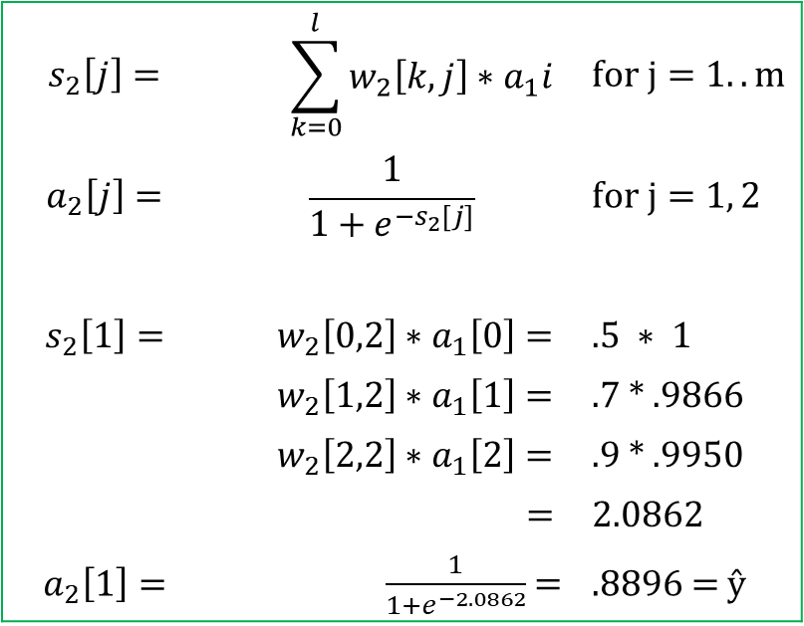
Forward Propagation
$$x, y$$
$$w_{1}[i,k]$$
$$w_{2}[k,j]$$
x₁ | x₂ | x₃ | y₁ | y₂
1.0000 | 4.0000 | 5.0000 | 0.1000 | 0.0500
i | w[i,1] | w[i,2]
0 | 0.5 | 0.5
1 | 0.1 | 0.2
2 | 0.3 | 0.4
3 | 0.5 | 0.6
k | w[k,1] | w[k,2]
0 | 0.5 | 0.5
1 | 0.7 | 0.8
2 | 0.9 | 0.1
$$a_{2}\left[j\right]$$
$$s_{2}\left[j\right]=$$ | $$\sum_{k=0}^{l}{w_{2}\left[k,j\right]∗a_{1}i}$$ | $$for j=1..m$$
$$a_{2}\left[j\right]=$$ | $$\frac{1}{{1+e}^{{−s}_{2}[j]}}$$ | $$for j=1, 2$$
$$s_{2}\left[1\right]=$$ | $$w_{2}\left[0,2\right]∗a_{1}\left[0\right]=$$ | $$.5 ∗ 1$$
 | $$w_{2}\left[1,2\right]∗a_{1}\left[1\right]=$$ | .7 * .9866
 | $$w_{2}\left[2,2\right]∗a_{1}\left[2\right]=$$ | .9 * .9950
 | $=$ | 2.0862
$$a_{2}\left[1\right]=$$ | $\frac{1}{{1+e}^{−2.0862}}$ = | $$.8896\text{ = }\text{ŷ}$$
$$a_{2}[1]$$
$$a_{2}[2]$$
$$a_{1}[k]$$
1
$$a_{1}[0]$$
$$a_{1}[1]$$
$$a_{1}[2]$$
$$a_{0}[i]$$
1
1
4
5
$$a_{0}[0]$$
$$a_{0}[1]$$
$$a_{0}[2]$$
$$a_{0}[3]$$

Slide 12
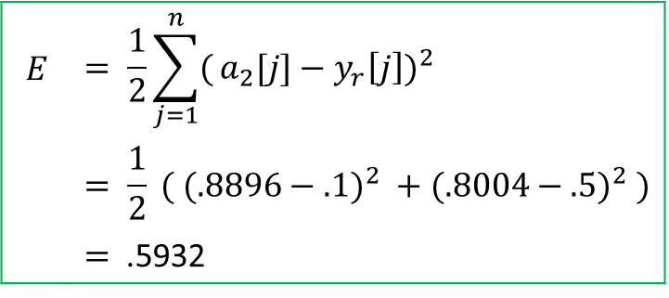

Error
y1
Desired - .1
y2
.05
$$x, y$$
$$w_{1}[i,k]$$
$$w_{2}[k,j]$$
x₁ | x₂ | x₃ | y₁ | y₂
1.0000 | 4.0000 | 5.0000 | 0.1000 | 0.0500
i | w[i,1] | w[i,2]
0 | 0.5 | 0.5
1 | 0.1 | 0.2
2 | 0.3 | 0.4
3 | 0.5 | 0.6
k | w[k,1] | w[k,2]
0 | 0.5 | 0.5
1 | 0.7 | 0.8
2 | 0.9 | 0.1
Calculated - .8896
ŷ1
.8004
ŷ2
$$a_{2}\left[j\right]$$
$$E$$ | $$= \frac{1}{2}\sum_{j=1}^{n}{(}a_{2}[j]−y_{r}{\left[j\right])}^{2}$$
 | $$= \frac{1}{2} ( (.8896−.1)^{2} +(.8004−.5)^{2} )$$
 | $=$ .5932
$$a_{2}[1]$$
$$a_{2}[2]$$
$$a_{1}[k]$$
1
$$a_{1}[0]$$
$$a_{1}[1]$$
$$a_{1}[2]$$
$$a_{0}[i]$$
1
1
4
5
$$a_{0}[0]$$
$$a_{0}[1]$$
$$a_{0}[2]$$
$$a_{0}[3]$$

Slide 13


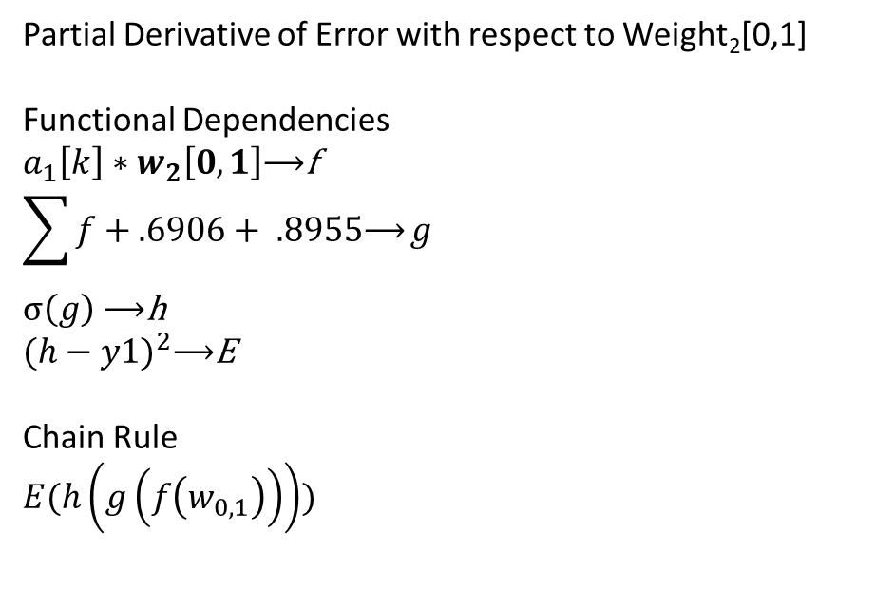
Backpropagation
$$E= .5932$$
y1
Desired - .1
y2
.05
$$x, y$$
$$w_{1}[i,k]$$
$$w_{2}[k,j]$$
x₁ | x₂ | x₃ | y₁ | y₂
1.0000 | 4.0000 | 5.0000 | 0.1000 | 0.0500
i | w[i,1] | w[i,2]
0 | 0.5 | 0.5
1 | 0.1 | 0.2
2 | 0.3 | 0.4
3 | 0.5 | 0.6
k | w[k,1] | w[k,2]
0 | 0.5 | 0.5
1 | 0.7 | 0.8
2 | 0.9 | 0.1
Calculated - .8896
ŷ1
.8004
ŷ2
$$a_{2}\left[j\right]$$
Partial Derivative of Error with respect to Weight₂[0,1]
Functional Dependencies
$$a_{1}\left[k\right]∗w_{2}\left[0,1\right]\text{⟶}\text{f}$$
$$\sum{f+.6906+ .8955\text{⟶}}g$$
$σ\left(g\right)$ $\text{⟶}\text{h}$
$$(h−y1)^{2}\text{⟶}\text{E}$$
Chain Rule
$$E(h\left(g\left(f\left(w_{0,1}\right)\right)\right))$$
$$a_{2}[1]$$
$$a_{2}[2]$$
$$w_{2}\left[0,1\right]$$
$$a_{1}[k]$$
1
$$a_{1}[0]$$
$$a_{1}[1]$$
$$a_{1}[2]$$
$$a_{0}[i]$$
1
1
4
5
$$a_{0}[0]$$
$$a_{0}[1]$$
$$a_{0}[2]$$
$$a_{0}[3]$$

Slide 14
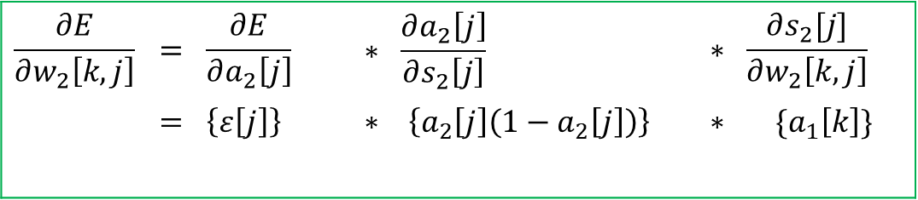

Backpropagation
y1
Desired - .1
y2
.05
$$x, y$$
$$w_{1}[i,k]$$
$$w_{2}[k,j]$$
x₁ | x₂ | x₃ | y₁ | y₂
1.0000 | 4.0000 | 5.0000 | 0.1000 | 0.0500
i | w[i,1] | w[i,2]
0 | 0.5 | 0.5
1 | 0.1 | 0.2
2 | 0.3 | 0.4
3 | 0.5 | 0.6
k | w[k,1] | w[k,2]
0 | 0.5 | 0.5
1 | 0.7 | 0.8
2 | 0.9 | 0.1
$$E= .5932$$
Calculated - .8896
ŷ1
.8004
ŷ2
$$a_{2}\left[j\right]$$
$$\frac{∂E}{∂w_{2}\left[k,j\right]}$$ | $$= \frac{∂E}{∂a_{2}\left[j\right]}$$ | $$∗ \frac{∂a_{2}\left[j\right]}{∂s_{2}\left[j\right]}$$ | $$∗ \frac{∂s_{2}[j]}{∂w_{2}\left[k,j\right]}$$
 | $$= \left\{ε\left[j\right]\right\}$$ | $$∗ \left\{a_{2}\left[j\right]\left(1−a_{2}\left[j\right]\right)\right\}$$ | $$∗ \{a_{1}\left[k\right]\}$$
$$a_{2}[1]$$
$$a_{2}[2]$$
$$a_{1}[k]$$
1
$$a_{1}[0]$$
$$a_{1}[1]$$
$$a_{1}[2]$$
$$a_{0}[i]$$
1
1
4
5
$$a_{0}[0]$$
$$a_{0}[1]$$
$$a_{0}[2]$$
$$a_{0}[3]$$

Slide 15


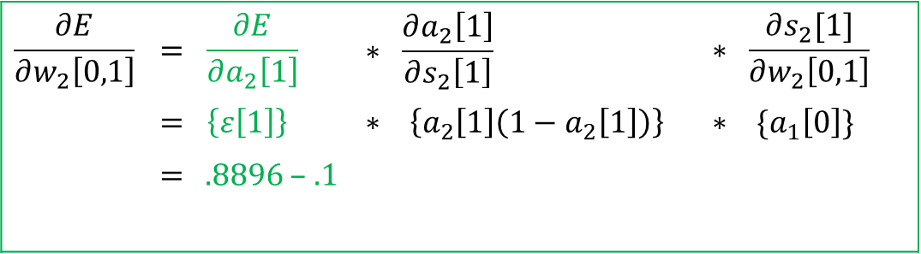
Backpropagation
y1
Desired - .1
y2
.05
$$x, y$$
$$w_{1}[i,k]$$
$$w_{2}[k,j]$$
x₁ | x₂ | x₃ | y₁ | y₂
1.0000 | 4.0000 | 5.0000 | 0.1000 | 0.0500
i | w[i,1] | w[i,2]
0 | 0.5 | 0.5
1 | 0.1 | 0.2
2 | 0.3 | 0.4
3 | 0.5 | 0.6
k | w[k,1] | w[k,2]
0 | 0.5 | 0.5
1 | 0.7 | 0.8
2 | 0.9 | 0.1
Calculated - .8896
ŷ1
.8004
ŷ2
$$ε[1]$$
$$a_{2}\left[j\right]$$
$$\frac{∂E}{∂w_{2}\left[0,1\right]}$$ | $$= \frac{∂E}{∂a_{2}\left[1\right]}$$ | $$∗ \frac{∂a_{2}\left[1\right]}{∂s_{2}\left[1\right]}$$ | $$∗ \frac{∂s_{2}[1]}{∂w_{2}\left[0,1\right]}$$
 | $$= \left\{ε\left[1\right]\right\}$$ | $$∗ \left\{a_{2}\left[1\right]\left(1−a_{2}\left[1\right]\right)\right\}$$ | $$∗ \{a_{1}\left[0\right]\}$$
 | $=$ .8896 – .1
$$a_{2}[1]$$
$$a_{2}[2]$$
$$w_{2}[0,1]$$
$$a_{1}[k]$$
1
$$a_{1}[0]$$
$$a_{1}[1]$$
$$a_{1}[2]$$
$$a_{0}[i]$$
1
1
4
5
$$a_{0}[0]$$
$$a_{0}[1]$$
$$a_{0}[2]$$
$$a_{0}[3]$$

Slide 16
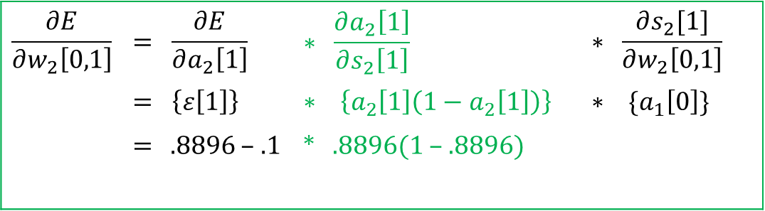

Backpropagation
y1
Desired - .1
y2
.05
$$x, y$$
$$w_{1}[i,k]$$
$$w_{2}[k,j]$$
x₁ | x₂ | x₃ | y₁ | y₂
1.0000 | 4.0000 | 5.0000 | 0.1000 | 0.0500
i | w[i,1] | w[i,2]
0 | 0.5 | 0.5
1 | 0.1 | 0.2
2 | 0.3 | 0.4
3 | 0.5 | 0.6
k | w[k,1] | w[k,2]
0 | 0.5 | 0.5
1 | 0.7 | 0.8
2 | 0.9 | 0.1
Calculated - .8896
ŷ1
.8004
ŷ2
$$ε[1]$$
$$a_{2}\left[j\right]$$
$$\frac{∂E}{∂w_{2}\left[0,1\right]}$$ | $$= \frac{∂E}{∂a_{2}\left[1\right]}$$ | $$∗ \frac{∂a_{2}\left[1\right]}{∂s_{2}\left[1\right]}$$ | $$∗ \frac{∂s_{2}[1]}{∂w_{2}\left[0,1\right]}$$
 | $$= \left\{ε\left[1\right]\right\}$$ | $$∗ \left\{a_{2}\left[1\right]\left(1−a_{2}\left[1\right]\right)\right\}$$ | $$∗ \{a_{1}\left[0\right]\}$$
 | $=$ .8896 – .1 | * .8896(1 – .8896)
$$a_{2}[1]$$
$$a_{2}[2]$$
$$w_{2}[0,1]$$
$$a_{1}[k]$$
1
$$a_{1}[0]$$
$$a_{1}[1]$$
$$a_{1}[2]$$
$$a_{0}[i]$$
1
1
4
5
$$a_{0}[0]$$
$$a_{0}[1]$$
$$a_{0}[2]$$
$$a_{0}[3]$$

Slide 17

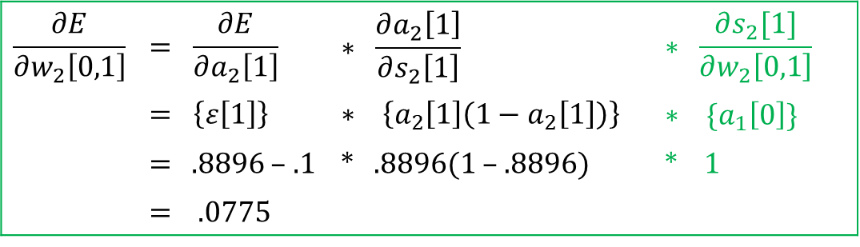
Backpropagation
y1
Desired - .1
y2
.05
$$x, y$$
$$w_{1}[i,k]$$
$$w_{2}[k,j]$$
x₁ | x₂ | x₃ | y₁ | y₂
1.0000 | 4.0000 | 5.0000 | 0.1000 | 0.0500
i | w[i,1] | w[i,2]
0 | 0.5 | 0.5
1 | 0.1 | 0.2
2 | 0.3 | 0.4
3 | 0.5 | 0.6
k | w[k,1] | w[k,2]
0 | 0.5 | 0.5
1 | 0.7 | 0.8
2 | 0.9 | 0.1
Calculated - .8896
ŷ1
.8004
ŷ2
$$ε[1]$$
$$a_{2}\left[j\right]$$
$$\frac{∂E}{∂w_{2}\left[0,1\right]}$$ | $$= \frac{∂E}{∂a_{2}\left[1\right]}$$ | $$∗ \frac{∂a_{2}\left[1\right]}{∂s_{2}\left[1\right]}$$ | $$∗ \frac{∂s_{2}[1]}{∂w_{2}\left[0,1\right]}$$
 | $$= \left\{ε\left[1\right]\right\}$$ | $$∗ \left\{a_{2}\left[1\right]\left(1−a_{2}\left[1\right]\right)\right\}$$ | $$∗ \{a_{1}\left[0\right]\}$$
 | $=$ .8896 – .1 | * .8896(1 – .8896) | * 1
 | = .0775
$$a_{2}[1]$$
$$a_{2}[2]$$
$$w_{2}[0,1]$$
$$a_{1}[k]$$
1
$$a_{1}[0]$$
$$a_{1}[1]$$
$$a_{1}[2]$$
$$a_{0}[i]$$
1
1
4
5
$$c_{2}[k,j]$$
$$a_{0}[0]$$
$$a_{0}[1]$$
$$a_{0}[2]$$
$$a_{0}[3]$$
k | c[k,1] | c[k,2]
0 | .0775 | 0
1 | 0 | 0
2 | 0 | 0

Slide 18






Computational Graphs
$$w .5$$
$$1$$
$$f(w, b)$$
*
$$z .5$$
$$b 1$$
$$.5$$

Slide 19
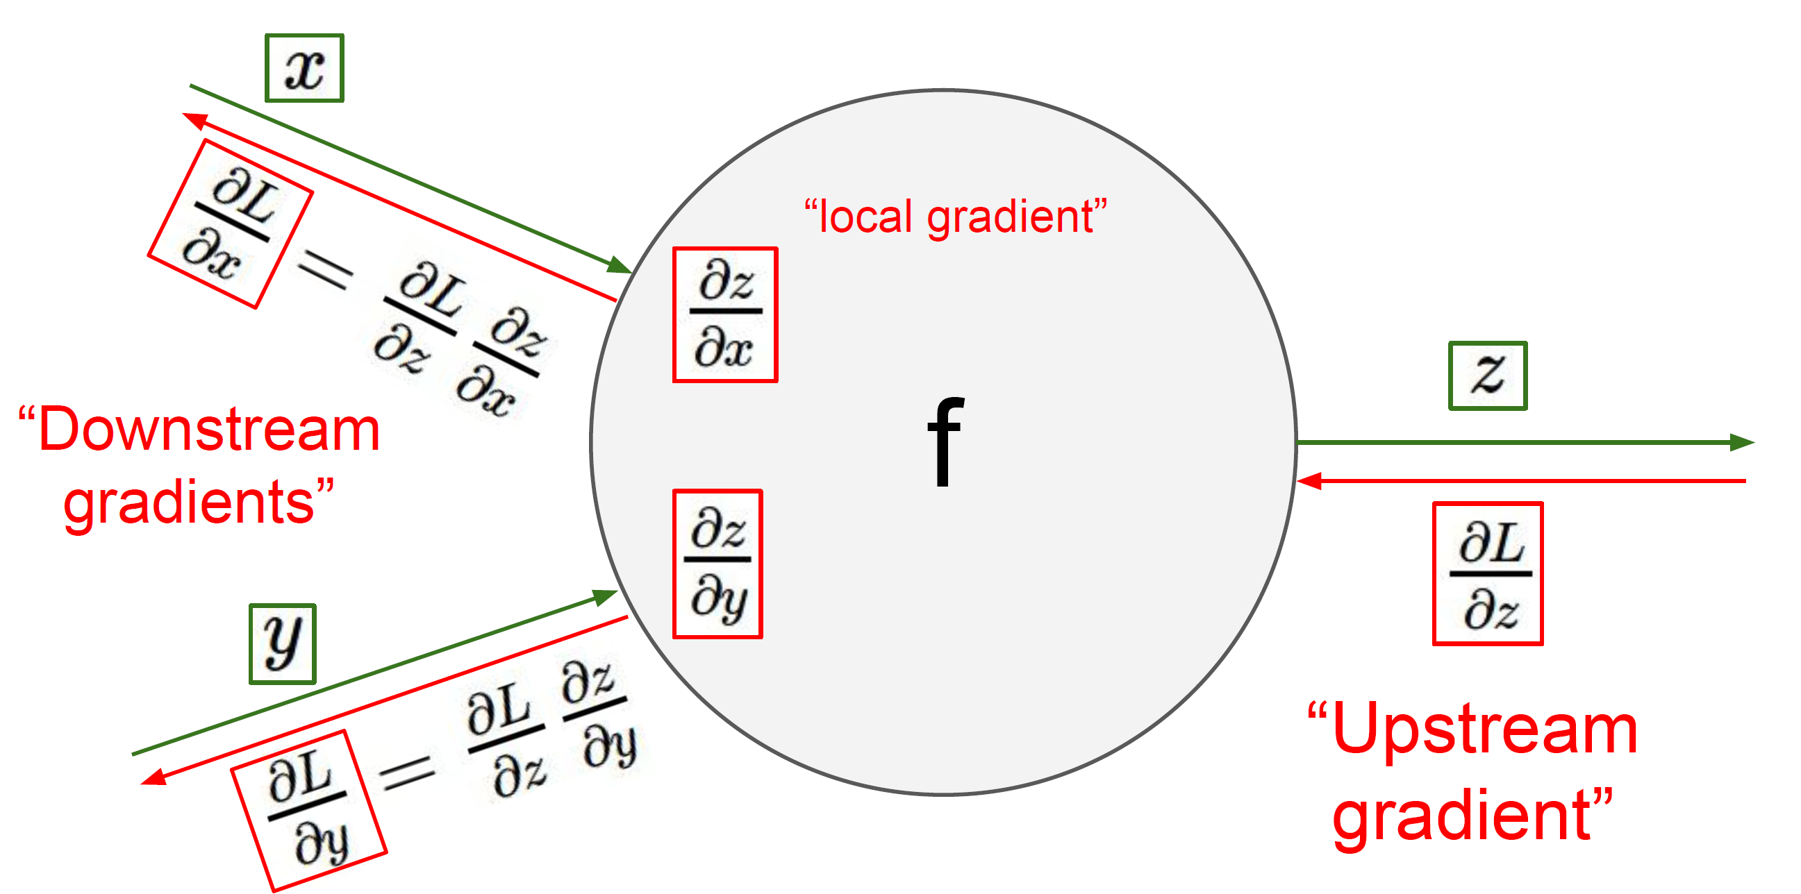
Computational Graphs
$$w .5$$
$$1$$
$$f(w, b)$$
*
$$z .5$$
$$b 1$$
$$.5$$
cs231n_2019_lecture04.pdf (stanford.edu)

Slide 20















Computational Graphs
$$w .5$$
$$1$$
*
$$.5$$
$$1$$
$$b 1$$
$$.5$$
+
$$2.0862$$
$$.7$$
$$.9866$$
*
$$.6906$$
$$1$$
$$.9866$$
$$.7$$
+
$$1.5861$$
$$.9$$
$$1$$
$$.9950$$
*
$$.8955$$
$$1$$
$$.9950$$
$$.9$$

Slide 21



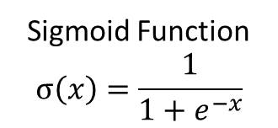



Computational Graphs
$$w .5$$
Sigmoid Function
$$σ\left(x\right)=\frac{1}{1+e^{−x}}$$
$$1$$
*
$$.5$$
$$1$$
$$b 1$$
$$.5$$
+
$$2.0862$$
*
$$−2.0862$$
exp
$$.1242$$
+
$$1.1242$$
1/x
$$.8896$$
$$.7$$
$$.9866$$
$$−1$$
$$1$$
*
$$.6906$$
$$1$$
$$.9866$$
$$.7$$
+
$$1.5861$$
$$.9$$
$$1$$
$$.9950$$
*
$$.8955$$
$$1$$
$$.9950$$
$$.9$$

Slide 22












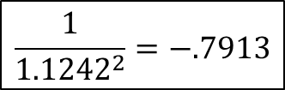







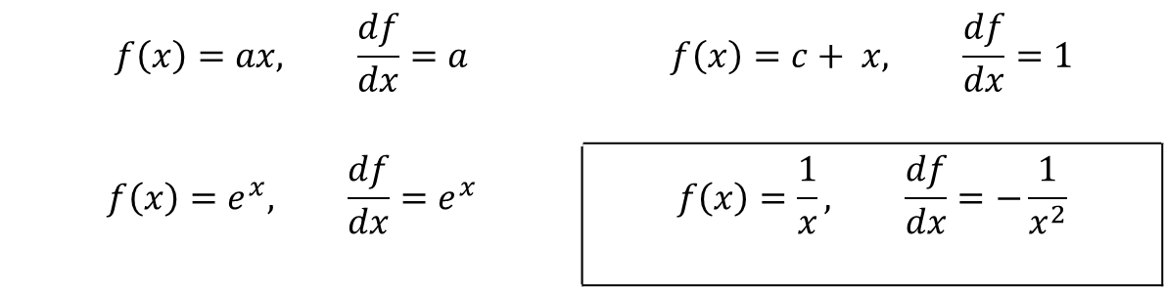

Computational Graphs
$$w .5$$
Sigmoid Function
$$σ\left(x\right)=\frac{1}{1+e^{−x}}$$
$$1$$
*
$$.5$$
$$1$$
$$b 1$$
$$.5$$
+
$$2.0862$$
*
$$−2.0862$$
exp
$$.1242$$
+
$$1.1242$$
1/x
$$.8896$$
$$−.7913 x 1$$
$$1.0000$$
$$.7$$
$$.9866$$
$$−1$$
$$1$$
$$\frac{1}{{1.1242}^{2}}=−.7913$$
*
$$.6906$$
$$1$$
$$.9866$$
$$.7$$
+
$$1.5861$$
$$.9$$
$$1$$
$$f\left(x\right)=ax, \frac{df}{dx}=a$$ | $$f\left(x\right)=c+ x, \frac{df}{dx}=1$$
$$f\left(x\right)=e^{x}, \frac{df}{dx}=e^{x}$$ | $$f\left(x\right)=\frac{1}{x}, \frac{df}{dx}=−\frac{1}{x^{2}}$$
$$.9950$$
*
$$.8955$$
$$1$$
$$.9950$$
$$.9$$

Slide 23



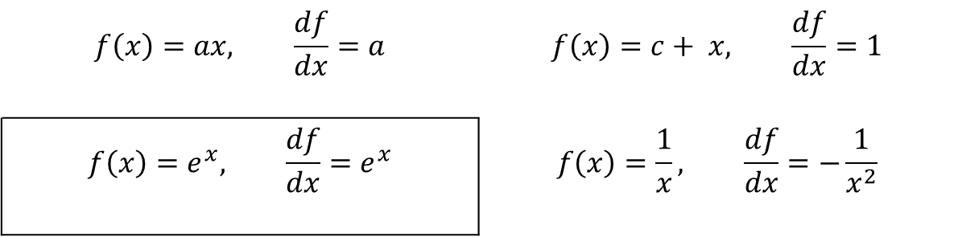
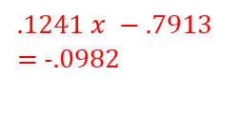
Computational Graphs
$$w .5$$
Sigmoid Function
$$σ\left(x\right)=\frac{1}{1+e^{−x}}$$
$$1$$
*
$$.5$$
$$1$$
$$b 1$$
$$.5$$
+
$$2.0862$$
*
$$−2.0862$$
exp
$$.1242$$
+
$$1.1242$$
1/x
$$.8896$$
$$1 x −.7913$$
$$−.7913 x 1$$
$$1.0000$$
$$−1 x −.0982$$
=.0982
$$.1241 x −.7913$$
= -.0982
$$.7$$
$$.9866$$
$$−1$$
$$1$$
*
$$.6906$$
$$1 x −.7913$$
$$1$$
$e^{−2.0862}=$ .1241
$$.9866$$
$$.7$$
+
$$1.5861$$
$$.9$$
$$1$$
$$f\left(x\right)=ax, \frac{df}{dx}=a$$ | $$f\left(x\right)=c+ x, \frac{df}{dx}=1$$
$$f\left(x\right)=e^{x}, \frac{df}{dx}=e^{x}$$ | $$f\left(x\right)=\frac{1}{x}, \frac{df}{dx}=−\frac{1}{x^{2}}$$
$$.9950$$
*
$$.8955$$
$$1$$
$$.9950$$
$$.9$$

Slide 24
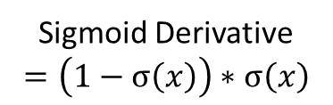

Computational Graphs
$$w .5$$
Sigmoid Function
$$σ\left(x\right)=\frac{1}{1+e^{−x}}$$
$$1$$
*
$$.5$$
$$1$$
$$b 1$$
$$.5$$
+
$$2.0862$$
*
$$−2.0862$$
exp
$$.1242$$
+
$$1.1242$$
1/x
$$.8896$$
$$1 x −.7913$$
$$−.7913 x 1$$
$$1.0000$$
$$−1 x −.0982$$
=.0982
$$.1241 x −.7913$$
= -.0982
$$.7$$
$$.9866$$
$$−1$$
$$1$$
*
$$.6906$$
$$1 x −.7913$$
$$1$$
$$.9866$$
$$.7$$
+
$$1.5861$$
$$\left(1−.8896\right).8896= .0982$$
$$.9$$
$$1$$
$$.9950$$
*
$$.8955$$
$$1$$
Sigmoid Derivative
$$=\left(1−σ\left(x\right)\right)∗σ\left(x\right)$$
$$.9950$$
$$.9$$

Slide 25



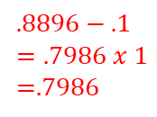





Computational Graphs
$$w .5$$
$$1∗.0775$$
$$=.0775$$
*
$$.5$$
$1$*.0775
=.0775
$$b 1$$
$$.5$$
+
$$2.0862$$
$$\hat{y} .8896$$
E
$$.3117$$
$.0982x$.7896
=.0775
$$.8896−.1$$
$$=.7986 x 1$$
=.7986
$$1$$
$$.7$$
$$.9866$$
$$−1$$
$$y$$
.$1$
*
$$.6906$$
$$1$$
$$.9866$$
$$.7$$
+
$$1.5861$$
$$.9$$
$$1$$
$$.9950$$
*
$$.8955$$
$$1$$
$$.9950$$
$$.9$$

Slide 26
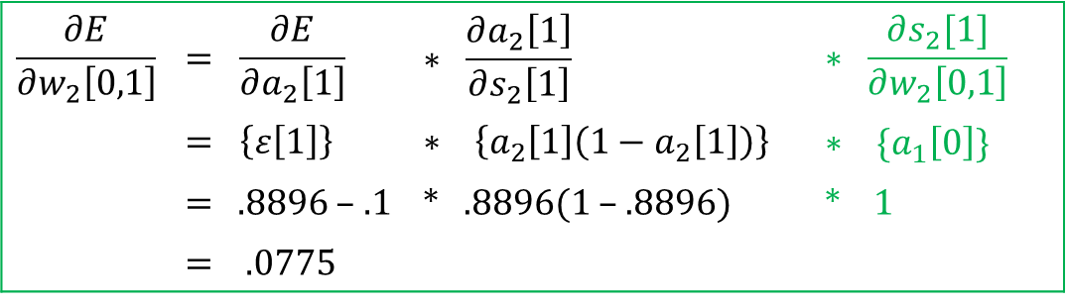
Computational Graphs
y1
Desired - .1
y2
.05
$$x, y$$
$$w_{1}[i,k]$$
$$w_{2}[k,j]$$
x₁ | x₂ | x₃ | y₁ | y₂
1.0000 | 4.0000 | 5.0000 | 0.1000 | 0.0500
i | w[i,1] | w[i,2]
0 | 0.5 | 0.5
1 | 0.1 | 0.2
2 | 0.3 | 0.4
3 | 0.5 | 0.6
k | w[k,1] | w[k,2]
0 | 0.5 | 0.5
1 | 0.7 | 0.8
2 | 0.9 | 0.1
Calculated - .8896
ŷ1
.8004
ŷ2
$$ε[1]$$
$$a_{2}\left[j\right]$$
$$\frac{∂E}{∂w_{2}\left[0,1\right]}$$ | $$= \frac{∂E}{∂a_{2}\left[1\right]}$$ | $$∗ \frac{∂a_{2}\left[1\right]}{∂s_{2}\left[1\right]}$$ | $$∗ \frac{∂s_{2}[1]}{∂w_{2}\left[0,1\right]}$$
 | $$= \left\{ε\left[1\right]\right\}$$ | $$∗ \left\{a_{2}\left[1\right]\left(1−a_{2}\left[1\right]\right)\right\}$$ | $$∗ \{a_{1}\left[0\right]\}$$
 | $=$ .8896 – .1 | * .8896(1 – .8896) | * 1
 | = .0775
$$a_{2}[1]$$
$$a_{2}[2]$$
$$w_{2}[0,1]$$
$$a_{1}[k]$$
1
$$a_{1}[0]$$
$$a_{1}[1]$$
$$a_{1}[2]$$
$$a_{0}[i]$$
1
1
4
5
$$c_{2}[k,j]$$
$$a_{0}[0]$$
$$a_{0}[1]$$
$$a_{0}[2]$$
$$a_{0}[3]$$
k | c[k,1] | c[k,2]
0 | .0775 | 0
1 | 0 | 0
2 | 0 | 0

Slide 27


Computational Graphs
$$w .5$$
$$1∗.0775$$
$$=.0775$$
*
$$.5$$
$1$*.0775
=.0775
$$b 1$$
$$.5$$
+
$$2.0862$$
$$\hat{y} .8896$$
E
$$.3117$$
$.0982x$.7896
=.0775
$$.8896−.1$$
$$=.7986 x 1$$
=.7986
$$1$$
$$.7$$
$$.9866$$
$$−1$$
$$y$$
.$1$
*
$$.6906$$
$$1$$
$$.9866$$
$$.7$$
+
$$1.5861$$
$$1$$
$$.9$$
$$1$$
$$.9950$$
f
*
$$.8955$$
$$1+2=3$$
$$1$$
$$.9950$$
$$.9$$
$$2$$

Slide 28
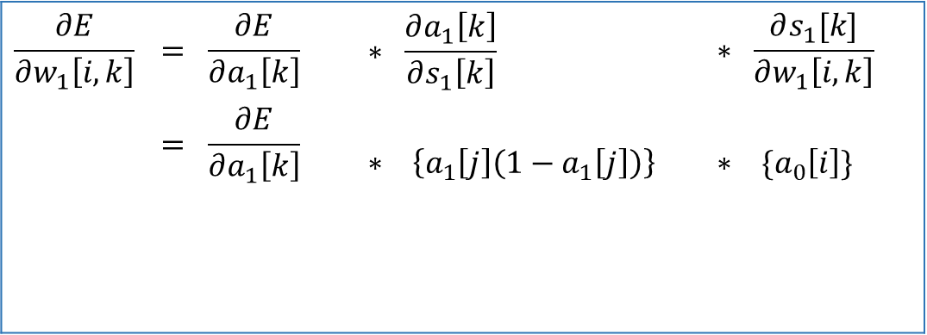
Backpropagation
y1
Desired - .1
y2
.05
$$x, y$$
$$w_{1}[i,k]$$
$$w_{2}[k,j]$$
x₁ | x₂ | x₃ | y₁ | y₂
1.0000 | 4.0000 | 5.0000 | 0.1000 | 0.0500
i | w[i,1] | w[i,2]
0 | 0.5 | 0.5
1 | 0.1 | 0.2
2 | 0.3 | 0.4
3 | 0.5 | 0.6
k | w[k,1] | w[k,2]
0 | 0.5 | 0.5
1 | 0.7 | 0.8
2 | 0.9 | 0.1
$$E= .5932$$
Calculated - .8896
ŷ1
.8004
ŷ2
$$a_{2}\left[j\right]$$
$$\frac{∂E}{∂w_{1}\left[i,k\right]}$$ | $$= \frac{∂E}{∂a_{1}\left[k\right]}$$ | $$∗ \frac{∂a_{1}\left[k\right]}{∂s_{1}\left[k\right]}$$ | $$∗ \frac{∂s_{1}[k]}{∂w_{1}\left[i, k\right]}$$
 | $$= \frac{∂E}{∂a_{1}\left[k\right]}$$ | $$∗ \left\{a_{1}\left[j\right]\left(1−a_{1}\left[j\right]\right)\right\}$$ | $$∗ \{a_{0}\left[i\right]\}$$
$$a_{2}[1]$$
$$a_{2}[2]$$
$$a_{1}[k]$$
1
$$a_{1}[0]$$
$$a_{1}[1]$$
$$a_{1}[2]$$
$$a_{0}[i]$$
1
1
4
5
$$a_{0}[0]$$
$$a_{0}[1]$$
$$a_{0}[2]$$
$$a_{0}[3]$$

Slide 29
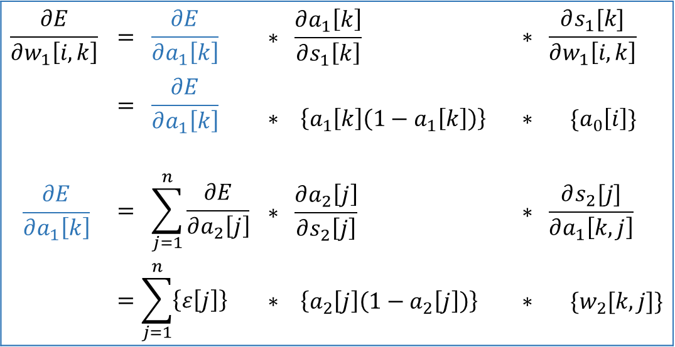



Backpropagation
y1
Desired - .1
y2
.05
$$x, y$$
$$w_{1}[i,k]$$
$$w_{2}[k,j]$$
x₁ | x₂ | x₃ | y₁ | y₂
1.0000 | 4.0000 | 5.0000 | 0.1000 | 0.0500
i | w[i,1] | w[i,2]
0 | 0.5 | 0.5
1 | 0.1 | 0.2
2 | 0.3 | 0.4
3 | 0.5 | 0.6
k | w[k,1] | w[k,2]
0 | 0.5 | 0.5
1 | 0.7 | 0.8
2 | 0.9 | 0.1
Calculated - .8896
ŷ1
.8004
ŷ2
$$ε[1]$$
$$ε[2]$$
$$a_{2}\left[j\right]$$
$$\frac{∂E}{∂w_{1}\left[i,k\right]}$$ | $$= \frac{∂E}{∂a_{1}\left[k\right]}$$ | $$∗ \frac{∂a_{1}\left[k\right]}{∂s_{1}\left[k\right]}$$ | $$∗ \frac{∂s_{1}[k]}{∂w_{1}\left[i, k\right]}$$
 | $$= \frac{∂E}{∂a_{1}\left[k\right]}$$ | $$∗ \left\{a_{1}\left[k\right]\left(1−a_{1}\left[k\right]\right)\right\}$$ | $$∗ \{a_{0}\left[i\right]\}$$
$$\frac{∂E}{∂a_{1}\left[k\right]}$$ | $$= \sum_{j=1}^{n}{\frac{∂E}{∂a_{2}\left[j\right]}}$$ | $$∗ \frac{∂a_{2}\left[j\right]}{∂s_{2}\left[j\right]}$$ | $$∗ \frac{∂s_{2}[j]}{∂a_{1}\left[k,j\right]}$$
 | $$=\sum_{j=1}^{n}{\left\{ε\left[j\right]\right\}}$$ | $$∗ \left\{a_{2}\left[j\right]\left(1−a_{2}\left[j\right]\right)\right\}$$ | $$∗ \{w_{2}[k,j]\}$$
$$a_{2}[1]$$
$$a_{2}[2]$$
$$a_{1}[k]$$
1
$$a_{1}[0]$$
$$a_{1}[1]$$
$$a_{1}[2]$$
$$w_{1}[0,1]$$
$$a_{0}[i]$$
1
1
4
5
$$a_{0}[0]$$
$$a_{0}[1]$$
$$a_{0}[2]$$
$$a_{0}[3]$$

Slide 30
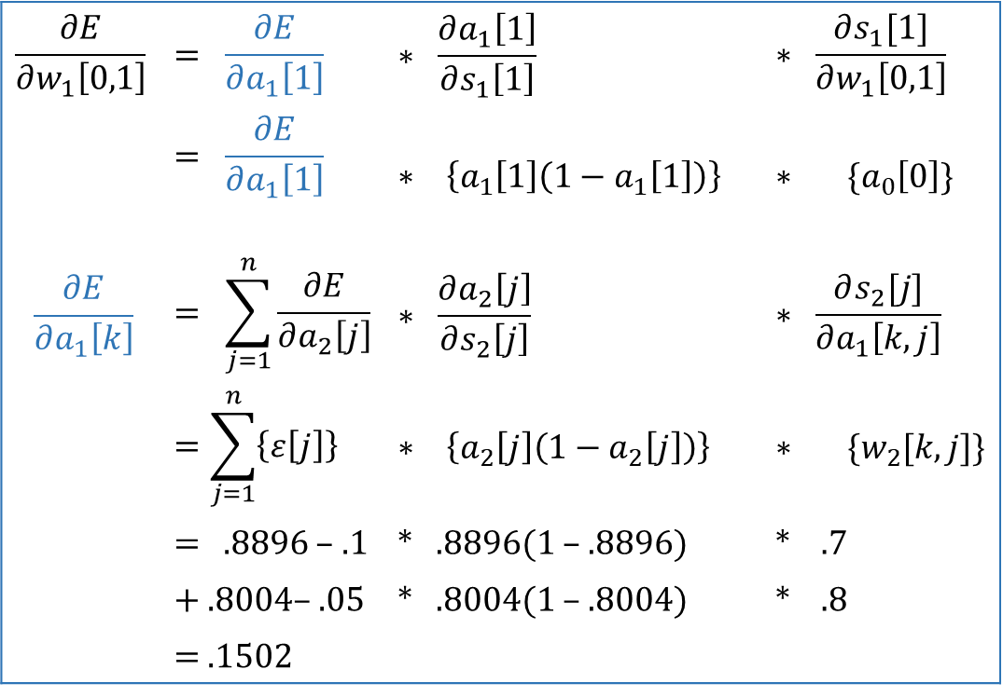

Backpropagation
y1
Desired - .1
y2
.05
$$x, y$$
$$w_{1}[i,k]$$
$$w_{2}[k,j]$$
x₁ | x₂ | x₃ | y₁ | y₂
1.0000 | 4.0000 | 5.0000 | 0.1000 | 0.0500
i | w[i,1] | w[i,2]
0 | 0.5 | 0.5
1 | 0.1 | 0.2
2 | 0.3 | 0.4
3 | 0.5 | 0.6
k | w[k,1] | w[k,2]
0 | 0.5 | 0.5
1 | 0.7 | 0.8
2 | 0.9 | 0.1
Calculated - .8896
ŷ1
.8004
ŷ2
$$ε[1]$$
$$ε[2]$$
$$a_{2}\left[j\right]$$
$$\frac{∂E}{∂w_{1}\left[0,1\right]}$$ | $$= \frac{∂E}{∂a_{1}\left[1\right]}$$ | $$∗ \frac{∂a_{1}\left[1\right]}{∂s_{1}\left[1\right]}$$ | $$∗ \frac{∂s_{1}[1]}{∂w_{1}\left[0,1\right]}$$
 | $$= \frac{∂E}{∂a_{1}\left[1\right]}$$ | $$∗ \left\{a_{1}\left[1\right]\left(1−a_{1}\left[1\right]\right)\right\}$$ | $$∗ \{a_{0}\left[0\right]\}$$
$$\frac{∂E}{∂a_{1}\left[k\right]}$$ | $$= \sum_{j=1}^{n}{\frac{∂E}{∂a_{2}\left[j\right]}}$$ | $$∗ \frac{∂a_{2}\left[j\right]}{∂s_{2}\left[j\right]}$$ | $$∗ \frac{∂s_{2}[j]}{∂a_{1}\left[k,j\right]}$$
 | $$=\sum_{j=1}^{n}{\left\{ε\left[j\right]\right\}}$$ | $$∗ \left\{a_{2}\left[j\right]\left(1−a_{2}\left[j\right]\right)\right\}$$ | $$∗ \{w_{2}[k, j]\}$$
 | $=$ .8896 – .1 | * .8896(1 – .8896) | * .7
 | $+$ .8004– .05 | * .8004(1 – .8004) | * .8
 | $=$ .1502
$$a_{2}[1]$$
$$a_{2}[2]$$
$$a_{1}[k]$$
1
$$a_{1}[0]$$
$$a_{1}[1]$$
$$a_{1}[2]$$
$$w_{1}[0,1]$$
$$a_{0}[i]$$
1
1
4
5
$$a_{0}[0]$$
$$a_{0}[1]$$
$$a_{0}[2]$$
$$a_{0}[3]$$

Slide 31
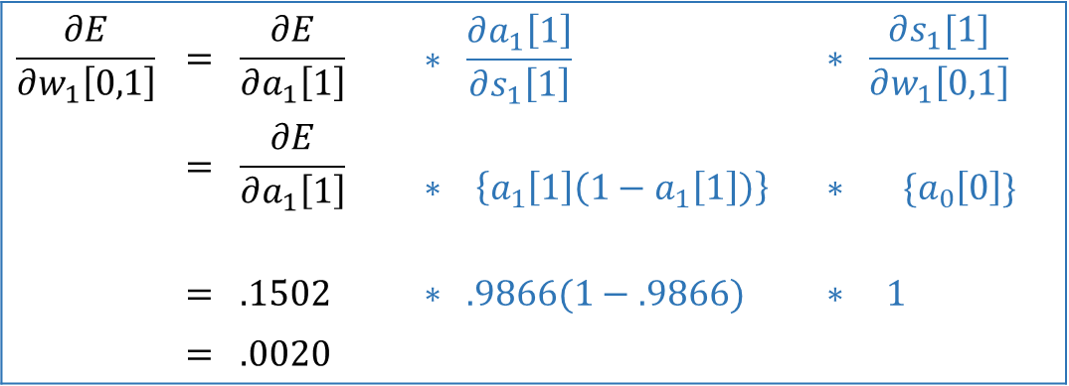



Backpropagation
y1
Desired - .1
y2
.05
$$x, y$$
$$w_{1}[i,k]$$
$$w_{2}[k,j]$$
x₁ | x₂ | x₃ | y₁ | y₂
1.0000 | 4.0000 | 5.0000 | 0.1000 | 0.0500
i | w[i,1] | w[i,2]
0 | 0.5 | 0.5
1 | 0.1 | 0.2
2 | 0.3 | 0.4
3 | 0.5 | 0.6
k | w[k,1] | w[k,2]
0 | 0.5 | 0.5
1 | 0.7 | 0.8
2 | 0.9 | 0.1
Calculated - .8896
ŷ1
.8004
ŷ2
$$ε[1]$$
$$ε[2]$$
$$a_{2}\left[j\right]$$
$$\frac{∂E}{∂w_{1}\left[0,1\right]}$$ | $$= \frac{∂E}{∂a_{1}\left[1\right]}$$ | $$∗ \frac{∂a_{1}\left[1\right]}{∂s_{1}\left[1\right]}$$ | $$∗ \frac{∂s_{1}[1]}{∂w_{1}\left[0,1\right]}$$
 | $$= \frac{∂E}{∂a_{1}\left[1\right]}$$ | $$∗ \left\{a_{1}\left[1\right]\left(1−a_{1}\left[1\right]\right)\right\}$$ | $$∗ \{a_{0}\left[0\right]\}$$
 | $$= .1502$$ | $$∗ .9866(1−.9866)$$ | $$∗ 1$$
 | $$= .0020$$
$$a_{2}[1]$$
$$a_{2}[2]$$
$$a_{1}[k]$$
1
$$a_{1}[0]$$
$$a_{1}[1]$$
$$a_{1}[2]$$
$$w_{1}[0,1]$$
$$a_{0}[i]$$
1
1
4
5
$$c_{1}[i,k]$$
$$a_{0}[0]$$
$$a_{0}[1]$$
$$a_{0}[2]$$
$$a_{0}[3]$$
i | w[i,1] | w[i,2]
0 | .0020 | 0
1 | 0 | 0
2 | 0 | 0
3 | 0 | 0

Slide 32




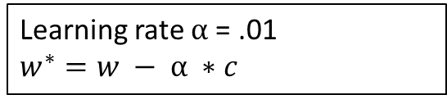
Backpropagation
Desired - y1
$$x, y$$
$$w_{1}[i,k]$$
$$w_{2}[k,j]$$
y2
x₁ | x₂ | x₃ | y₁ | y₂
1.0000 | 4.0000 | 5.0000 | 0.1000 | 0.0500
0.1000 | -5.0000 | 3.0000 | 0.1221 | 0.0964
6.0000 | -5.5420 | 4.8970 | 0.1061 | 0.0702
4.0000 | 8.0000 | 9.0000 | 0.0996 | 0.0641
12.0000 | -2.0000 | 0.0063 | 0.1110 | 0.0732
6.0000 | -5.5000 | 4.8970 | 0.1060 | 0.0701
i | w[i,1] | w[i,2]
0 | 0.5 | 0.5
1 | 0.1 | 0.2
2 | 0.3 | 0.4
3 | 0.5 | 0.6
k | w[k,1] | w[k,2]
0 | 0.5 | 0.5
1 | 0.7 | 0.8
2 | 0.9 | 0.1
r =1
Calculated - ŷ1
ŷ2
…
$$ε[1]$$
$$ε[2]$$
r =4
$$c_{1}[i,k]$$
$$c_{2}[k,j]$$
$$a_{2}\left[j\right]$$
i | w[i,1] | w[i,2]
0 | .0604 | .0332
1 | .1134 | .0427
2 | -.2929 | -.1658
3 | .2193 | .1129
k | c[k,1] | c[k,2]
0 | .3447 | .4816
1 | .2929 | .4176
2 | .2930 | .4191
$$a_{2}[1]$$
$$a_{2}[2]$$
$$a_{1}[k]$$
Learning rate $α$= .01
$$w^{∗}=w − α ∗c$$
1
$${w_{1}}^{∗} [i,k]$$
$${w_{2}}^{∗}[k,j]$$
$$a_{1}[0]$$
$$a_{1}[1]$$
$$a_{1}[2]$$
i | w[i,1] | w[i,2]
0 | .4994 | .4997
1 | .0989 | .1996
2 | .3029 | .4017
3 | .4978 | .5989
k | w[k,1] | w[k,2]
0 | .4966 | .0039
1 | .4971 | .0038
2 | .0021 | .0004
$$a_{0}[i]$$
1
1
4
5
$$a_{0}[0]$$
$$a_{0}[1]$$
$$a_{0}[2]$$
$$a_{0}[3]$$

Slide 33
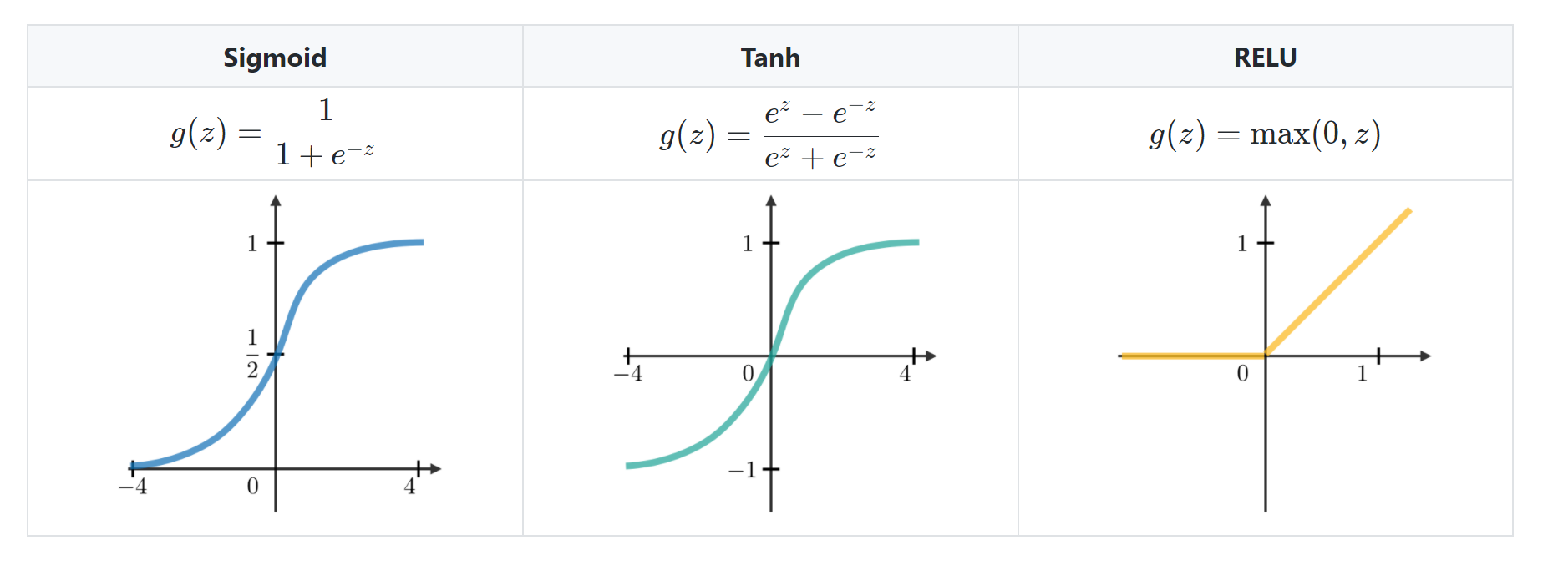
Backpropagation
$$w .5$$
$$1∗.0775$$
$$=.0775$$
*
$$.5$$
$1$*.0775
=.0775
$$b 1$$
$$.5$$
+
$$2.0862$$
$$\hat{y} .8896$$
E
$$.3117$$
$.0982x$.7896
=.0775
$$.8896−.1$$
$$=.7986 x 1$$
=.7986
$$1$$
$$.7$$
$$.9866$$
$$−1$$
$$y$$
.$1$
*
$$.6906$$
$$1$$
$$.9866$$
$$.7$$
+
$$1.5861$$
$$.9$$
$$1$$
$$.9950$$
*
$$.8955$$
$$1$$
$$.9950$$
$$.9$$
CS 230 - Recurrent Neural Networks Cheatsheet (stanford.edu)

Slide 34


Character Prediction
y1
y2
y3
y4
“e”→ 0 1 0 0
“hello”
Vocabulary
“h” [1, 0, 0, 0]
“e” [0, 1, 0, 0]
“l” [0, 0, 1, 0]
“o” [0, 0, 0, 1]
ŷ1
ŷ2
ŷ3
ŷ4
$$a_{2}\left[j\right]$$
$$a_{2}[0]$$
$$a_{2}[1]$$
$$a_{2}[2]$$
$$a_{2}[3]$$
$$a_{1}[k]$$
$$a_{1}[0]$$
$$a_{1}[1]$$
$$a_{1}[2]$$
$$a_{0}[i]$$
x1
x2
x3
x4
$$a_{0}[0]$$
$$a_{0}[1]$$
$$a_{0}[2]$$
$$a_{0}[3]$$
“h”→ 1 0 0 0

Slide 35
Character Prediction
y1
y2
y3
y4
“e”→ 0 1 0 0
“hello”
Vocabulary
“h” [1, 0, 0, 0]
“e” [0, 1, 0, 0]
“l” [0, 0, 1, 0]
“o” [0, 0, 0, 1]
ŷ1
ŷ2
ŷ3
ŷ4
$$a_{2}\left[j\right]$$
$$a_{2}[0]$$
$$a_{2}[1]$$
$$a_{2}[2]$$
$$a_{2}[3]$$
$$a_{1}[k]$$
$$a_{1}[0]$$
$$a_{1}[1]$$
$$a_{1}[2]$$
“h”→ “e”
“e”→ “l”
“l” → “l”
“l” → “o”
“hel”→ “p”
“hell”→ “o”
“heliu” → “m”
$$a_{0}[i]$$
x1
x2
x3
x4
?
$$a_{0}[0]$$
$$a_{0}[1]$$
$$a_{0}[2]$$
$$a_{0}[3]$$
“h”→ 1 0 0 0
Ambiguous Targets
Fixed Width Input/Output

Slide 36
Character Prediction
y1
y2
y3
y4
“e”→ 0 1 0 0
“hello”
Vocabulary
“h” [1, 0, 0, 0]
“e” [0, 1, 0, 0]
“l” [0, 0, 1, 0]
“o” [0, 0, 0, 1]
ŷ1
ŷ2
ŷ3
ŷ4
$$a_{2}\left[j\right]$$
$$a_{2}[0]$$
$$a_{2}[1]$$
$$a_{2}[2]$$
$$a_{2}[3]$$
$$a_{1}[k]$$
$$a_{1}[0]$$
$$a_{1}[1]$$
$$a_{1}[2]$$
“h”→ “e”
“e”→ “l”
“l” → “l”
“l” → “o”
$$a_{0}[i]$$
x1
x2
x3
x4
?
$$a_{0}[0]$$
$$a_{0}[1]$$
$$a_{0}[2]$$
$$a_{0}[3]$$
“h”→ 1 0 0 0
Ambiguous Targets

Slide 37
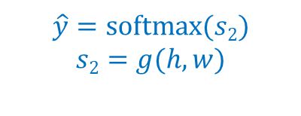
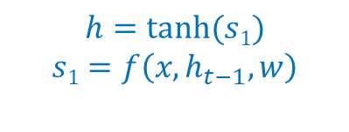
Recurrent Neural Networks
y1
y2
y3
y4
“e”→ 0 1 0 0
ŷ1
ŷ2
ŷ3
ŷ4
$$\hat{y}=softmax⁡(s2)$$
$$s2=g(h,w)$$
$$a_{2}\left[j\right]$$
y
$$a_{1}[k]$$
$$h=tanh⁡(s1)$$
$$s1=f\left(x, h_{t−1}, w\right)$$
h
$$a_{0}[i]$$
x1
x2
x3
x4
x
“h”→ 1 0 0 0
t

Slide 38


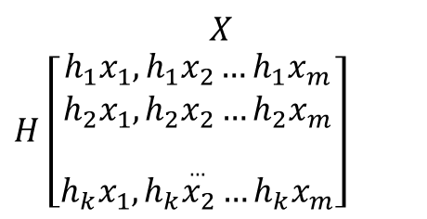


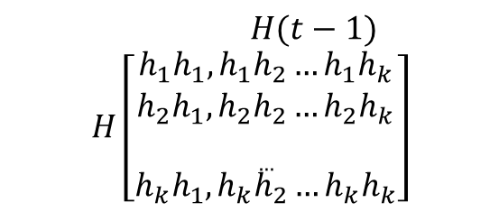

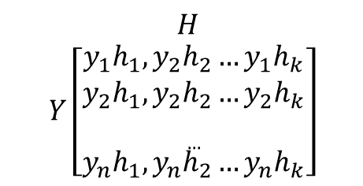

Recurrent Neural Networks
$$W_{yh}$$
$$H$$
$$Y\left[\begin{aligned}y_{1}h_{1},y_{2}h_{2}…y_{1}h_{k} \\ y_{2}h_{1},y_{2}h_{2}…y_{2}h_{k} \\ … \\ y_{n}h_{1},y_{n}h_{2}…y_{n}h_{k}\end{aligned}\right]$$
y
$$H(t−1)$$
$$H\left[\begin{aligned}h_{1}h_{1},h_{1}h_{2}…h_{1}h_{k} \\ h_{2}h_{1},h_{2}h_{2}…h_{2}h_{k} \\ … \\ h_{k}h_{1},h_{k}h_{2}…h_{k}h_{k}\end{aligned}\right]$$
$$w_{yh}$$
$$W_{hh}$$
h
$$w_{hh}$$
$$w_{xh}$$
$$X$$
$H$ $\left[\begin{aligned}h_{1}x_{1},h_{1}x_{2}…h_{1}x_{m} \\ h_{2}x_{1},h_{2}x_{2}…h_{2}x_{m} \\ … \\ h_{k}x_{1},h_{k}x_{2}…h_{k}x_{m}\end{aligned}\right]$
x
$$W_{xh}$$

Slide 39
Recurrent Neural Networks
$$\hat{y}=softmax⁡(s2)$$
$$s2=g(h,w)$$
y
h₀
h
$$h=tanh⁡(s1)$$
$$s1=f\left(x, h_{t−1}, w\right)$$
x
t=1

Slide 40
Recurrent Neural Networks
y
y
h₀
h
h
x
x
t=1
t=2

Slide 41
Recurrent Neural Networks
y
y
y
y
h₀
h
h
h
h
x
x
x
x
t=1 t=2 t=3 t=4

Slide 42
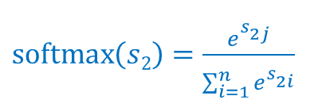
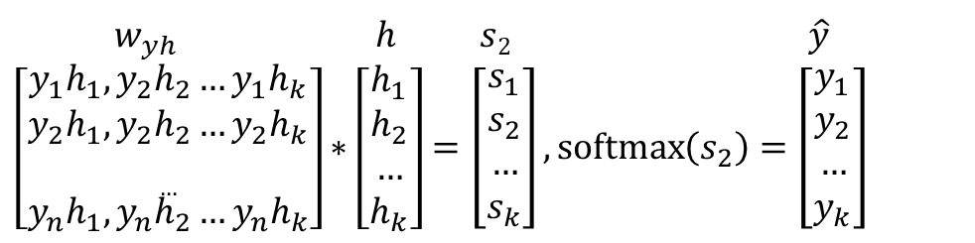
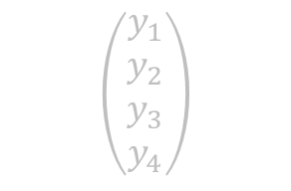
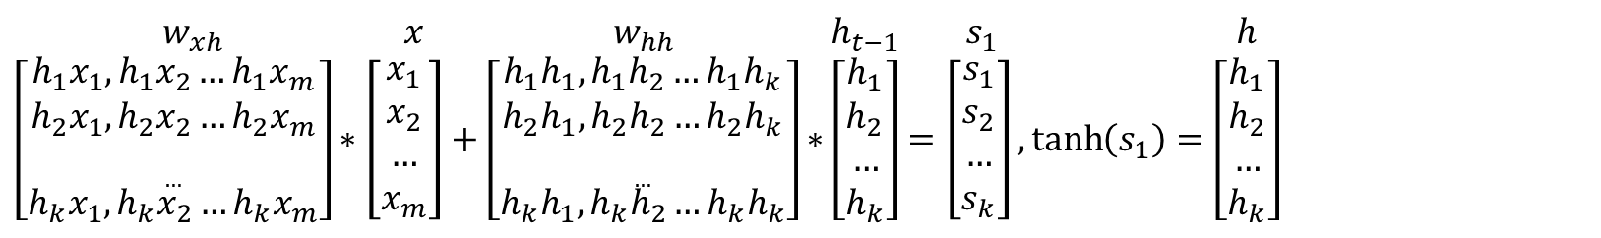

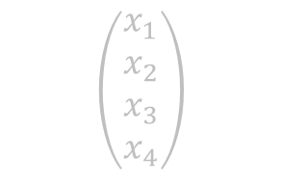
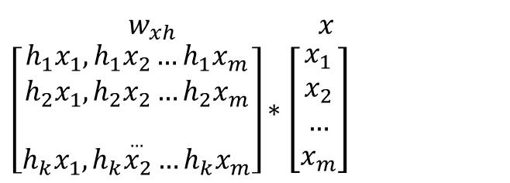

Recurrent Neural Networks
$w_{yh} h s2 \hat{y}$
$$\left[\begin{aligned}y_{1}h_{1},y_{2}h_{2}…y_{1}h_{k} \\ y_{2}h_{1},y_{2}h_{2}…y_{2}h_{k} \\ … \\ y_{n}h_{1},y_{n}h_{2}…y_{n}h_{k}\end{aligned}\right]∗\left[\begin{aligned}h_{1} \\ h_{2} \\ … \\ h_{k}\end{aligned}\right]=\left[\begin{aligned}s_{1} \\ s_{2} \\ … \\ s_{k}\end{aligned}\right], \operatorname{softmax}\left(s_{2}\right)=\left[\begin{aligned}y_{1} \\ y_{2} \\ … \\ y_{k}\end{aligned}\right]$$
$$\left(\begin{aligned}y_{1} \\ y_{2} \\ y_{3} \\ y_{4}\end{aligned}\right)$$
$\operatorname{softmax}\left(s2\right)=\frac{e^{s_{2j}^{}}}{\sum_{i=1}^{n}{e^{s_{2i}^{}}}}$
y
$$w_{xh} x w_{hh} h_{t−1} s_{1} h$$
$$\left[\begin{aligned}h_{1}x_{1},h_{1}x_{2}…h_{1}x_{m} \\ h_{2}x_{1},h_{2}x_{2}…h_{2}x_{m} \\ … \\ h_{k}x_{1},h_{k}x_{2}…h_{k}x_{m}\end{aligned}\right]∗\left[\begin{aligned}x_{1} \\ x_{2} \\ … \\ x_{m}\end{aligned}\right]+\left[\begin{aligned}h_{1}h_{1},h_{1}h_{2}…h_{1}h_{k} \\ h_{2}h_{1},h_{2}h_{2}…h_{2}h_{k} \\ … \\ h_{k}h_{1},h_{k}h_{2}…h_{k}h_{k}\end{aligned}\right]∗\left[\begin{aligned}h_{1} \\ h_{2} \\ … \\ h_{k}\end{aligned}\right]=\left[\begin{aligned}s_{1} \\ s_{2} \\ … \\ s_{k}\end{aligned}\right], \tanh\left(s_{1}\right)=\left[\begin{aligned}h_{1} \\ h_{2} \\ … \\ h_{k}\end{aligned}\right]$$
$$\left(\begin{aligned}h_{1} \\ h_{2} \\ h_{3}\end{aligned}\right)$$
h
$tanh{(s}_{1})=\frac{e^{2x}−1}{e^{2x}+1}$
$$w_{xh} x$$
$$\left[\begin{aligned}h_{1}x_{1},h_{1}x_{2}…h_{1}x_{m} \\ h_{2}x_{1},h_{2}x_{2}…h_{2}x_{m} \\ … \\ h_{k}x_{1},h_{k}x_{2}…h_{k}x_{m}\end{aligned}\right]∗\left[\begin{aligned}x_{1} \\ x_{2} \\ … \\ x_{m}\end{aligned}\right]$$
x
$$\left(\begin{aligned}x_{1} \\ x_{2} \\ x_{3} \\ x_{4}\end{aligned}\right)$$

Slide 43
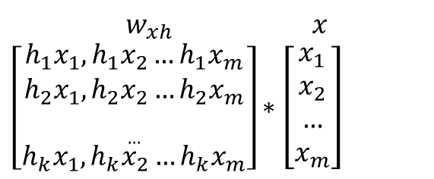
Recurrent Neural Networks
$w_{yh} h s2 \hat{y}$
$$\left[\begin{aligned}y_{1}h_{1},y_{2}h_{2}…y_{1}h_{k} \\ y_{2}h_{1},y_{2}h_{2}…y_{2}h_{k} \\ … \\ y_{n}h_{1},y_{n}h_{2}…y_{n}h_{k}\end{aligned}\right]∗\left[\begin{aligned}h_{1} \\ h_{2} \\ … \\ h_{k}\end{aligned}\right]=\left[\begin{aligned}s_{1} \\ s_{2} \\ … \\ s_{k}\end{aligned}\right], \operatorname{softmax}\left(s_{2}\right)=\left[\begin{aligned}y_{1} \\ y_{2} \\ … \\ y_{k}\end{aligned}\right]$$
y
$$w_{xh} x w_{hh} h_{t−1} s_{1} h$$
$$\left[\begin{aligned}h_{1}x_{1},h_{1}x_{2}…h_{1}x_{m} \\ h_{2}x_{1},h_{2}x_{2}…h_{2}x_{m} \\ … \\ h_{k}x_{1},h_{k}x_{2}…h_{k}x_{m}\end{aligned}\right]∗\left[\begin{aligned}x_{1} \\ x_{2} \\ … \\ x_{m}\end{aligned}\right]+\left[\begin{aligned}h_{1}h_{1},h_{1}h_{2}…h_{1}h_{k} \\ h_{2}h_{1},h_{2}h_{2}…h_{2}h_{k} \\ … \\ h_{k}h_{1},h_{k}h_{2}…h_{k}h_{k}\end{aligned}\right]∗\left[\begin{aligned}h_{1} \\ h_{2} \\ … \\ h_{k}\end{aligned}\right]=\left[\begin{aligned}s_{1} \\ s_{2} \\ … \\ s_{k}\end{aligned}\right], \tanh\left(s_{1}\right)=\left[\begin{aligned}h_{1} \\ h_{2} \\ … \\ h_{k}\end{aligned}\right]$$
h
$$w_{xh} x$$
$$\left[\begin{aligned}h_{1}x_{1},h_{1}x_{2}…h_{1}x_{m} \\ h_{2}x_{1},h_{2}x_{2}…h_{2}x_{m} \\ … \\ h_{k}x_{1},h_{k}x_{2}…h_{k}x_{m}\end{aligned}\right]∗\left[\begin{aligned}x_{1} \\ x_{2} \\ … \\ x_{m}\end{aligned}\right]$$
h_{t-1}
x

Slide 44


Recurrent Neural Networks
$$L_{total}=−\sum_{t=1}^{n}{y_{t}log⁡(\hat{y})}$$
“e” “l” “l” “0”
$$L_{t}=−y_{t}log⁡(\hat{y})$$
Multi-class Cross Entropy Loss
L1 L2 L3 L4
ŷ
ŷ
ŷ
ŷ
h₀
h
h
h
h
“h” “e” “l” “l”
t=1 t=2 t=3 t=4

Slide 45


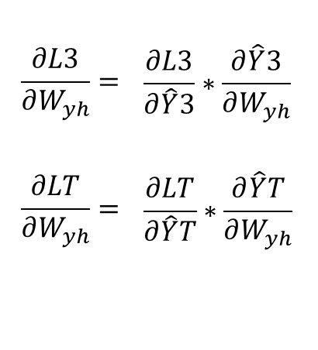
Recurrent Neural Networks
$$L_{total}=−\sum_{t=1}^{n}{y_{t}log⁡(\hat{y})}$$
“e” “l” “l”
$$\frac{∂L3}{∂W_{yh}}=$$ | $$\frac{∂L3}{∂\hat{Y}3}∗\frac{∂\hat{Y}3}{∂W_{yh}}$$
$$\frac{∂LT}{∂W_{yh}}=$$ | $$\frac{∂LT}{∂\hat{Y}T}∗\frac{∂\hat{Y}T}{∂W_{yh}}$$
$$L_{t}=−y_{t}log⁡(\hat{y})$$
L1 L2 L3
ŷ
ŷ
ŷ
$$w_{yh}$$
h₀
h
h
h
“h” “e” “l”
t=1 t=2 t=3
For derivatives of Softmax and Cross Entropy Loss
Part 2: Softmax Regression (saitcelebi.com)
How to compute the derivative of softmax and cross-entropy – Charlee Li

Slide 46


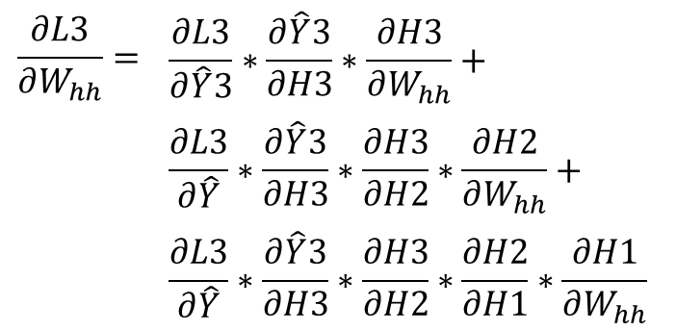

Recurrent Neural Networks
$$L_{total}=−\sum_{t=1}^{n}{y_{t}log⁡(\hat{y})}$$
“e” “l” “l”
$$\frac{∂L3}{∂W_{hh}}=$$ | $$\frac{∂L3}{∂\hat{Y}3}∗\frac{∂\hat{Y}3}{∂H3}∗\frac{∂H3}{∂W_{hh}}+$$
 | $$\frac{∂L3}{∂\hat{Y}}∗\frac{∂\hat{Y}3}{∂H3}∗\frac{∂H3}{∂H2}∗\frac{∂H2}{∂W_{hh}}+$$
 | $$\frac{∂L3}{∂\hat{Y}}∗\frac{∂\hat{Y}3}{∂H3}∗\frac{∂H3}{∂H2}∗\frac{∂H2}{∂H1}∗\frac{∂H1}{∂W_{hh}}$$
$$L_{t}=−y_{t}log⁡(\hat{y})$$
L1 L2 L3
ŷ
ŷ
ŷ
h₀
h
h
h
$$w_{hh}$$
$$w_{hh}$$
$$w_{hh}$$
“h” “e” “l”
t=1 t=2 t=3
For derivatives of Softmax and Cross Entropy Loss
Part 2: Softmax Regression (saitcelebi.com)
How to compute the derivative of softmax and cross-entropy – Charlee Li

Slide 47



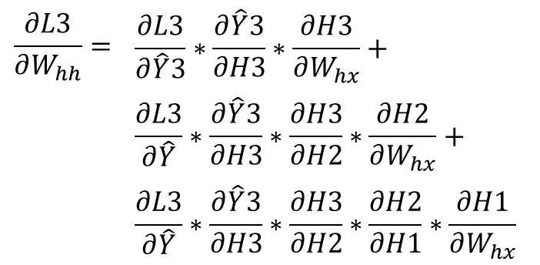

Recurrent Neural Networks
$$L_{total}=−\sum_{t=1}^{n}{y_{t}log⁡(\hat{y})}$$
“e” “l” “l”
$$\frac{∂L3}{∂W_{hh}}=$$ | $$\frac{∂L3}{∂\hat{Y}3}∗\frac{∂\hat{Y}3}{∂H3}∗\frac{∂H3}{∂W_{hx}}+$$
 | $$\frac{∂L3}{∂\hat{Y}}∗\frac{∂\hat{Y}3}{∂H3}∗\frac{∂H3}{∂H2}∗\frac{∂H2}{∂W_{hx}}+$$
 | $$\frac{∂L3}{∂\hat{Y}}∗\frac{∂\hat{Y}3}{∂H3}∗\frac{∂H3}{∂H2}∗\frac{∂H2}{∂H1}∗\frac{∂H1}{∂W_{hx}}$$
$$L_{t}=−y_{t}log⁡(\hat{y})$$
L1 L2 L3
ŷ
ŷ
ŷ
h₀
h
h
h
$$w_{hh}$$
$$w_{xh}$$
$$w_{xh}$$
$$w_{xh}$$
“h” “e” “l”
t=1 t=2 t=3
For derivatives of Softmax and Cross Entropy Loss
Part 2: Softmax Regression (saitcelebi.com)
How to compute the derivative of softmax and cross-entropy – Charlee Li

Slide 48
Recurrent Neural Networks
$$L_{total}=−\sum_{t=1}^{n}{y_{t}log⁡(\hat{y})}$$
“e” “l” “l”
$$\frac{∂L3}{∂W_{hh}}=$$ | $$\frac{∂L3}{∂\hat{Y}3}∗\frac{∂\hat{Y}3}{∂H3}∗\frac{∂H3}{∂W_{hx}}+$$
 | $$\frac{∂L3}{∂\hat{Y}}∗\frac{∂\hat{Y}3}{∂H3}∗\frac{∂H3}{∂H2}∗\frac{∂H2}{∂W_{hx}}+$$
 | $$\frac{∂L3}{∂\hat{Y}}∗\frac{∂\hat{Y}3}{∂H3}∗\frac{∂H3}{∂H2}∗\frac{∂H2}{∂H1}∗\frac{∂H1}{∂W_{hx}}$$
$$L_{t}=−y_{t}log⁡(\hat{y})$$
L1 L2 L3
ŷ
ŷ
ŷ
h₀
h
h
h
$$w_{hh}$$
$$w_{xh}$$
$$w_{xh}$$
$$w_{xh}$$
“h” “e” “l”
t=1 t=2 t=3
For derivatives of Softmax and Cross Entropy Loss
Part 2: Softmax Regression (saitcelebi.com)
How to compute the derivative of softmax and cross-entropy – Charlee Li

Slide 49
Recurrent Neural Networks
y
y
y
y
One-to-One
h
h
h
h
x
x
x
x

Slide 50
Recurrent Neural Networks
y
y
y
One-to-Many
h
h
h
h
x

Slide 51
Recurrent Neural Networks
y
Many-to-One
h
h
h
h
x
x
x

Slide 52
Recurrent Neural Networks
y
y
y
Many-to-Many
h
h
h
h
x
x

Slide 53
Recurrent Neural Networks
y
y
y
y
Generation
h
h
h
h
x
x
x
x

Slide 54
Recurrent Neural Networks
Vanishing Gradients
The bird that I really really really liked was flying

Slide 55
Long Short Term Memory
0 = forget
1 = retain
= | Signal Strength
c_{t-1}
+
c
x
x
x
h_{t-1}
W
h
+
x

Slide 56
Long Short Term Memory
c_{t-1}
+
c
x
x
x
h_{t-1}
W
h
+
Vector
Concatenation
x

Slide 57
Long Short Term Memory
Previous
Cell State
c_{t-1}
+
c
x
x
x
h_{t-1}
W
h
+
x

Slide 58
Long Short Term Memory
Forget Gate
c_{t-1}
+
c
x
x
x
h_{t-1}
W
h
+
x

Slide 59
Long Short Term Memory
Input Gate
c_{t-1}
+
c
x
x
x
h_{t-1}
W
h
+
x

Slide 60
Long Short Term Memory
Output Gate
c_{t-1}
+
c
x
x
x
h_{t-1}
W
h
+
x

Slide 61
Long Short Term Memory
x
+
c_{t-1}
+
c
x
x
x
h_{t-1}
W
h
+
x

Slide 62

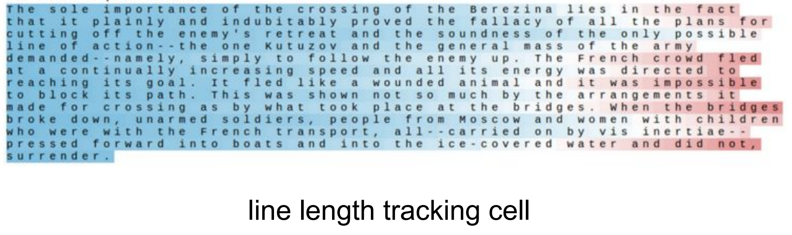
Long Short Term Memory

Slide 63
References
Backpropagation Example With Numbers Step by Step – A Not So Random Walk
cs231n_2019_lecture04.pdf (stanford.edu)
cs231n_2019_lecture10.pdf (stanford.edu)
cs231n_2017_lecture10.pdf (stanford.edu)
The Unreasonable Effectiveness of Recurrent Neural Networks (karpathy.github.io)
The Basics of Recurrent Neural Networks (RNNs) | by Ben Khuong | Towards AI
Illustrated Guide to Recurrent Neural Networks | by Michael Phi | Towards Data Science
Medium (towardsdatascience.com)
Back Propagation through time - RNN – GeeksforGeeks
SSIE 519 Notes

